Slide 1
Weather Data Analyzer & Temperature Prediction System
Historical Weather Analysis Using Machine Learning
Detecting Temperature Cycles | Seoul Weather Dataset | Linear Regression
PRESENTER NAME
Tanim Ahammed
COURSE NAME
Introduction to OSS
PROFESSOR NAME
Junaid Rashid
UNIVERSITY NAME
Sejong University

Slide 2
Why Weather Analysis & Prediction?
"Can a machine automatically identify relationships and forecast temperatures?"
🌐 Millions of data points daily
Meteorological sensors log massive climate records every second.
⚠️ Manual analysis is difficult
Too much variable traffic for humans to parse or analyze manually.
👁️ Patterns change frequently
Atmospheric variables change dynamically across annual cycles.
🤖 ML detects threats/trends
Algorithms uncover hidden correlations between metrics automatically.
🛡️ Visualizations improve clarity
Graphs and heatmaps convert raw variables into understandable insights.
✅ Our solution - prediction
OLS Linear Regression models forecast daily temp targets in real time.
2

Slide 3
Project Overview & Tech Stack
WHAT THE SYSTEM DOES
📦 Loads and preprocesses CSV datasets cleanly
📊 Calculates descriptive meteorological stats
🖼️ Generates 8 visual plot files dynamically
🤖 Trains Scikit-Learn Linear Regression engine
💾 Saves model binaries using local pickle files
🖥️ Provides responsive, modern desktop GUI panels
CORE SOFTWARE TECH STACK
Language Engine
Python 3.13
Database / Parsing
Pandas & NumPy
Predictive Library
Scikit-Learn (Linear Regression)
Visualizations
Matplotlib + Seaborn
GUI Framework
Tkinter Desktop Window Manager
Code Standards
README · LICENSE (MIT) · requirements.txt
3

Slide 4
Dataset Details & Suitability
733
DATASET RECORDS
seoul_weather_2022_to_2024.csv
33
TOTAL COLUMNS
Features mapped from source
Target
AVERAGE TEMP (TEMP)
Output forecast parameter
CORE WEATHER FEATURES DETECTED
● datetime | date index mapping ● tempmax | daily maximum temp thresholds ● tempmin | daily minimum temp thresholds ● humidity | moisture saturation percentage ● precip | precipitation volume logs in mm ● windspeed | average wind speed velocity ● conditions | categorical descriptors (Clear, Rain, Cloudy)
SUITABILITY FOR TEMPERATURE PREDICTION
• Strong natural correlations between temperature and variables like humidity/cloud cover.
• Contains multi-year sequential observations showing seasonal changes.
• Numerical weather variables demonstrate linear distributions ideal for Ordinary Least Squares (OLS) fitting.
• Data has high cleanliness with very few missing cells.
4

Slide 5
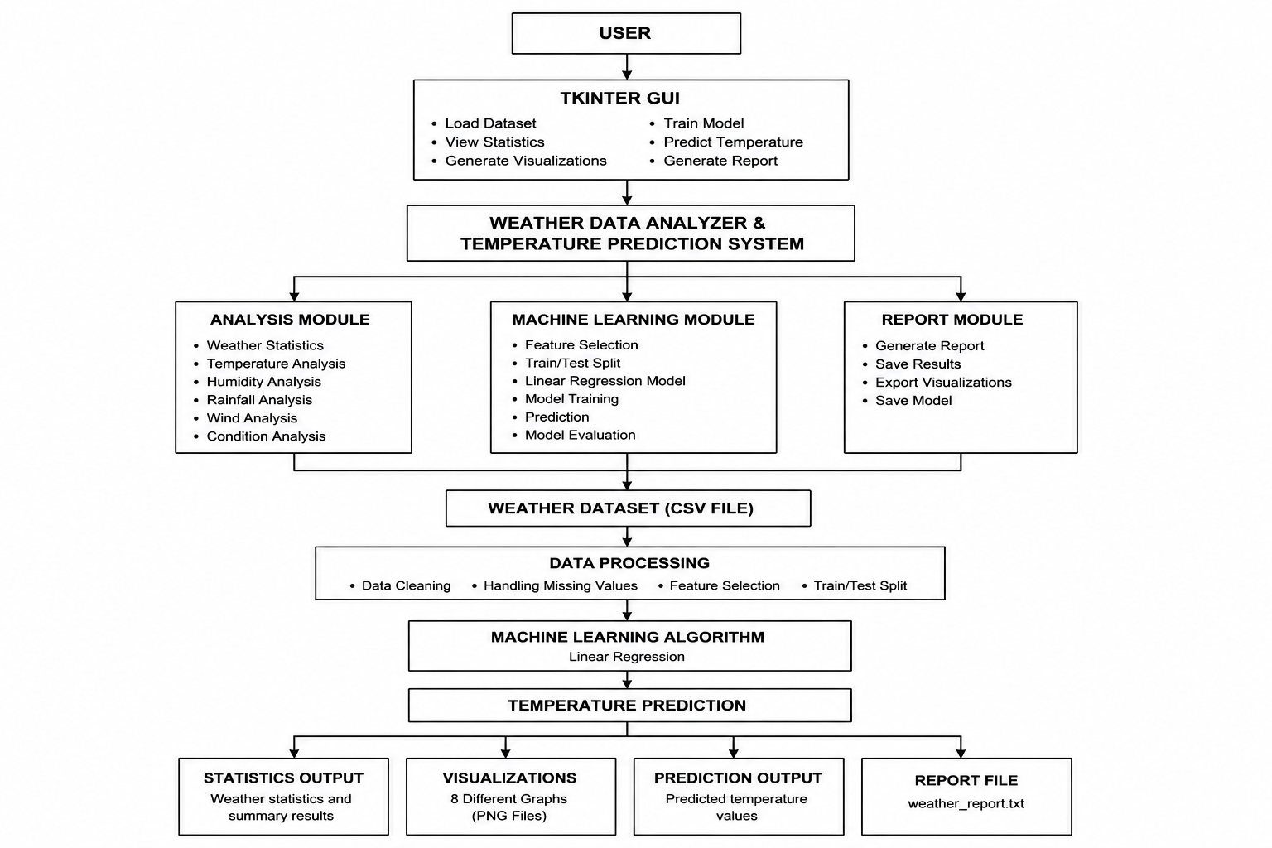
System Workflow & Pipeline Flow
5

Slide 6
Data Preprocessing Operations
🏷️ STEP 1 Regex Header Detection
Before: Requires strict hardcoded headers matching 'temp' or 'date'. After: Auto-scans columns using case-insensitive regex checks (e.g. temp, windspeed, humidity, precip). Result: Allows application to process diverse third-party climate formats.
🔢 STEP 2 Cleaning & Imputation
Missing Numbers: Fills null metrics dynamically using column average stats. Missing Text/Conditions: Fills missing textual fields with the column's statistical mode. Date Parsing: Converts dates to datetime objects and sorts records chronologically.
📐 STEP 3 Feature Selection & Split
Predictors Selection: Strips text, indices, and highly correlated features like tempmax/tempmin to prevent target leakage. Train/Test Split: Randomly partitions the dataset (80% train / 20% test validation) for evaluation. Fitted Scalars: Excludes scaling dependencies if model coefficients require raw unit interpretations.
6

Slide 7
Machine Learning: Linear Regression
Ordinary Least Squares (OLS) Regression
• Fits model weights by minimizing the sum of squared residuals between predictions and target labels.
• Model outputs are highly interpretable, showing exactly how each weather variable influences the target temperature.
• Lightweight architecture requiring zero GPU hardware acceleration.
• Trains on the dataset dynamically and saves weights to 'output/temperature_model.pkl'.
Features & Target Mapping
Target Variable
Daily Average Temperature (temp) in °C.
Input Features
Humidity, Precipitation, Wind Speed, Pressure, Cloud Cover, and others.
Training / Test Partition
80% Training records | 20% Holdout validation testing records.
Predictive Forecast Output
Continuous temperature value projection in Celsius.
7

Slide 8
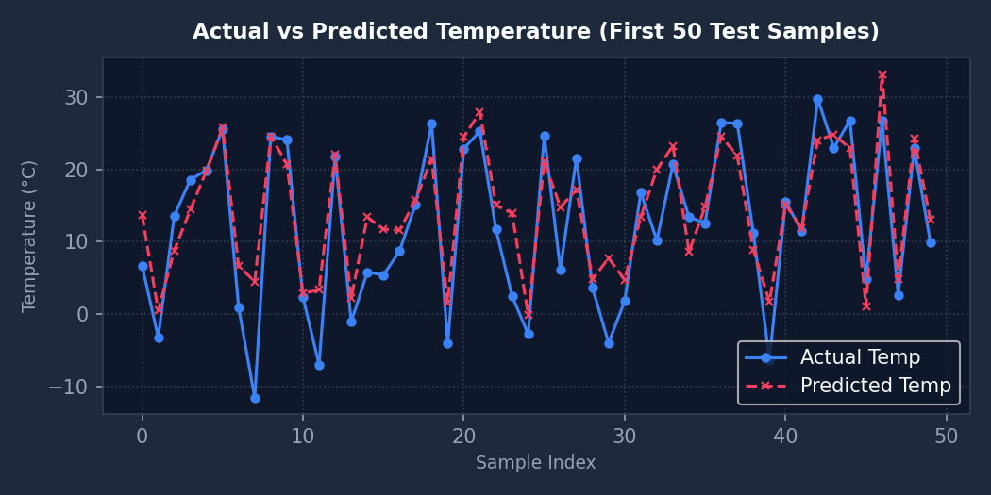
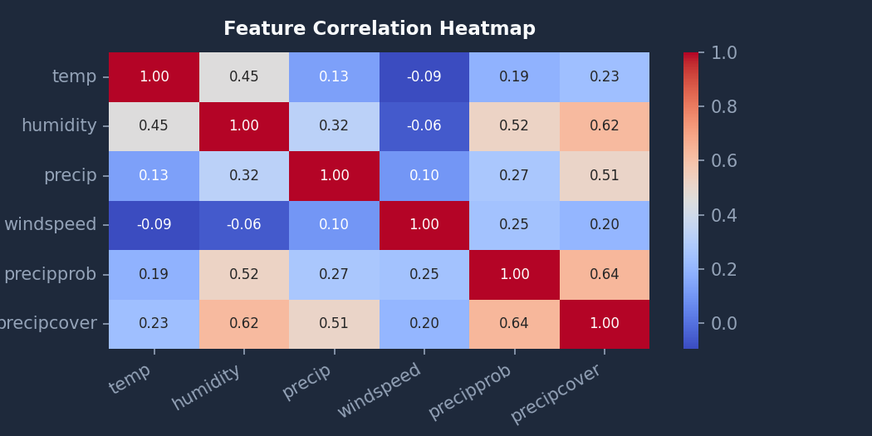
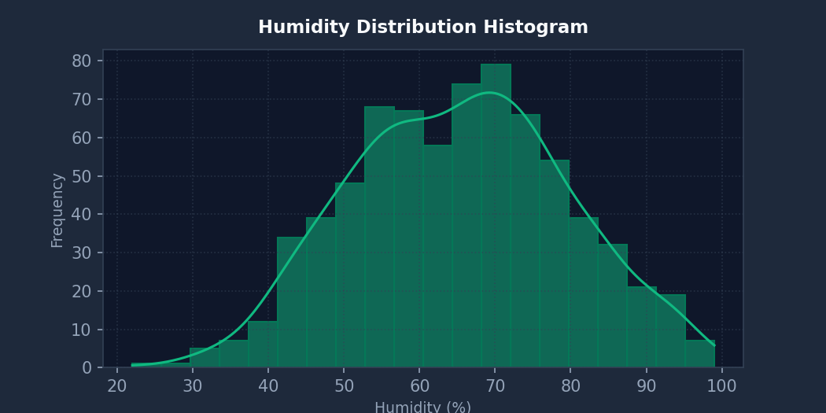
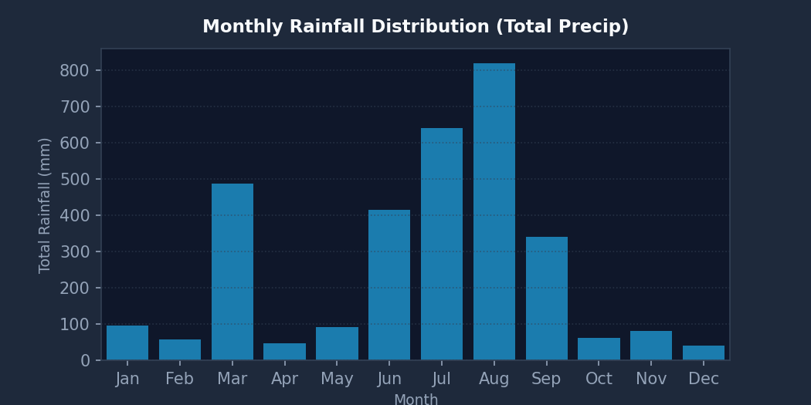
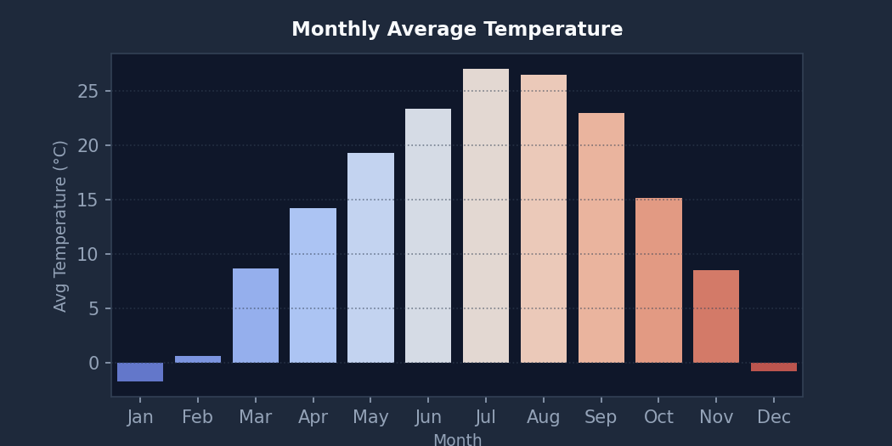
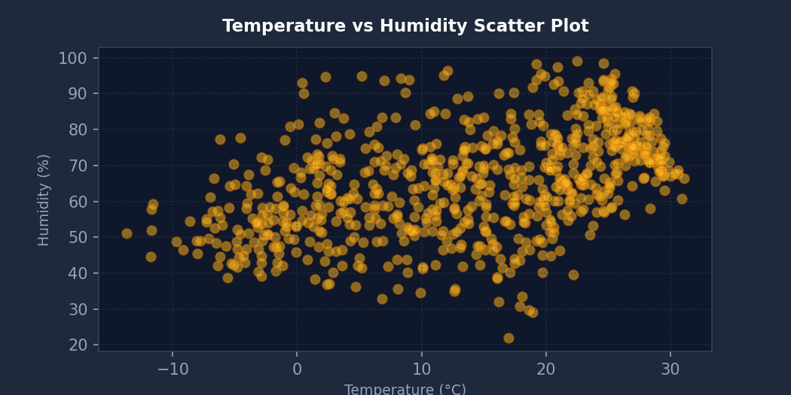
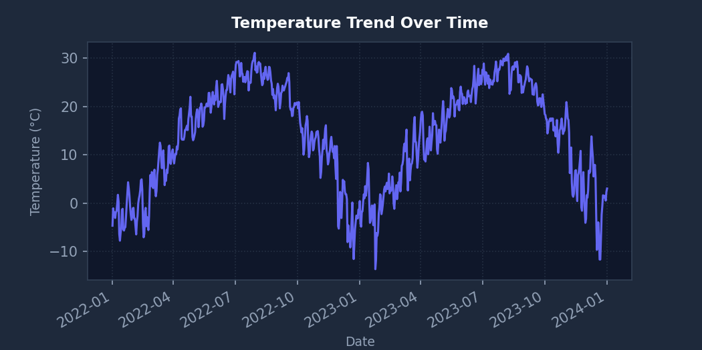
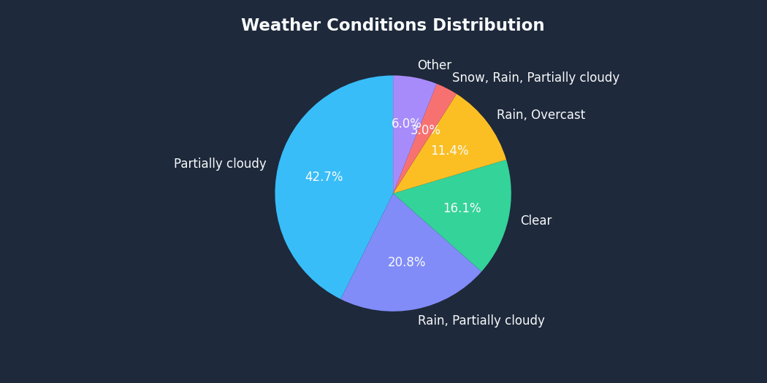
Results & Visualizations Catalog
8

Slide 9
Model Performance & Evaluation
Statistical Metrics Definitions
Mean Absolute Error (MAE)
The average absolute difference between predicted and actual values. Measures baseline error magnitude.
Mean Squared Error (MSE)
Average squared difference between target values and predictions. Penalizes larger outliers.
Root Mean Squared Error (RMSE)
Square root of MSE, scaling error values directly back to temperature units (°C).
Model Validation Performance
R² Score (R-squared): 0.7698
The model successfully accounts for ~77.0% of the temperature variance in test records.
MAE Performance: 4.1071 °C
On average, temperature predictions are off by ~4.1 °C.
RMSE Performance: 5.2512 °C
Standard deviation of prediction residuals is ~5.25 °C.
MSE Result: 27.5747
Slight variance penalty score representing model stability.
9

Slide 10
Desktop Interface GUI Modules
Ingestion & Analysis Views
Load Dataset File Dial
Opens local filesystem file dialogues to choose source CSV logs. Triggers background column regex detectors.
Dataset Schema Overview
Renders dataset columns structure, types list, null cell checks, and treeview preview data grids.
Weather Statistics Dashboard
Calculates maximums, minimums, averages, and rainfall totals, updating a grid of dashboard card views.
Model & Prediction Views
Generate Visualizations
Triggers chart rendering and saves PNGs. Embeds plots directly into the main GUI frame.
Model Training & Evaluation
Runs regression fits and evaluates test metrics. Displays actual vs. predicted curves.
Dynamic Temp Predictor
Dynamically generates entry fields based on features. Outputs predictions using color-coded badges (Blue for cold, Green for moderate, Red for hot).
Analytical Report Viewer
Compiles metrics into a formatted text file report and displays it in a read-only viewer.
10

Slide 11
Open Source Project Files
Repository File Configuration
README.md
Provides user documentation including setup requirements, execution guides, workflow charts, visual catalogs, and project structures.
requirements.txt
Specifies external dependency lists (scikit-learn, pandas, seaborn, matplotlib) to ensure reproducible installs.
LICENSE
Establishes legal rights. Uses the permissive MIT License, permitting modification, redistribution, and academic usage.
Open Source Value
• Ensures code transparency and standardizes layouts.
• Guarantees scientific reproducibility of ML models.
• Permits community contributions and fork modifications.
• Establishes clean repository rules for collaborative university submissions.
11

Slide 12
Project Structure & How to Run
PROJECT DIRECTORY STRUCTURE
Weather-Data-Analyzer/ | +-- main.py <- Application entry | |-- WeatherDataProcessor (data/ML logic) | |-- WeatherApp (Tkinter GUI engine) | +-- data/ | +-- seoul_weather_2022_to_2024.csv | +-- london_weather_sample.csv | +-- output/ | +-- temperature_trend.png | +-- correlation_heatmap.png | +-- ... (8 charts total) | +-- weather_report.txt | +-- requirements.txt +-- LICENSE +-- README.md
HOW TO LAUNCH THE APP
1. Clone Repository
git clone https://github.com/aperfectrio/weather-data-analyzer-and-prediction.git cd weather-data-analyzer-and-prediction
2. Install Dependencies
pip install -r requirements.txt
3. Run Python Application
python main.py
12

Slide 13
Summary, Conclusions & Roadmap
733
RECORDS TRAINED
1
REGRESSION MODEL
76.98%
VALIDATION ACCURACY
8
CHARTS SAVED
WHAT WAS BUILT
• Complete desktop weather data predictor platform.
• Automatic regex column detectors, data preprocessing, and descriptive stats aggregations.
• Interactive GUI forms that adapt dynamically to different CSV variables.
• Full open source docs: README.md, MIT LICENSE, requirements.
WHAT I LEARNED & FUTURE ROADMAP
Algorithm Extension
Support non-linear predictive algorithms (Random Forest, Gradient Boosting).
Live API Integration
Integrate OpenWeatherMap APIs to fetch live weather logs in-app.
Lessons Learned
Decoupling GUI structures from backend algorithms improves codebase clean-checks.
13

Slide 14
Thank You!

